Slide 1

Chapter 10: Project Communications Management
Information Technology Project Management, Seventh Edition
ĐẶNG THỊ THU HÀ – SE
dtthuha79@gmail.com
https://lms.iuh.edu.vn
.

Slide 2
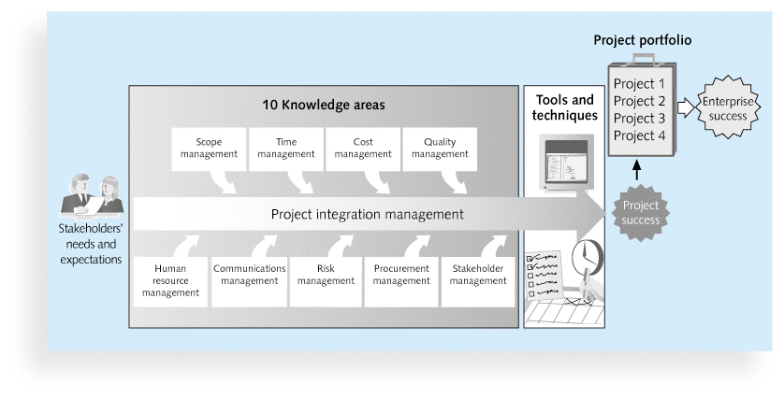

Slide 3
Learning Objectives
Understand the importance of good communications on projects and the need to develop soft skills, especially for IT project managers and their teams
Review key concepts related to communications
Explain the elements of planning project communications and how to create a communications management plan

Slide 4
Project Communications Management Processes
10.1.Planning communications management: Determining the information and communications needs of the stakeholders
10.2.Managing communications: Creating, distributing, storing, retrieving, and disposing of project communications based on the communications management plan
10.3.Controlling communications: Monitoring and controlling project communications to ensure that stakeholder communication needs are met

Slide 5
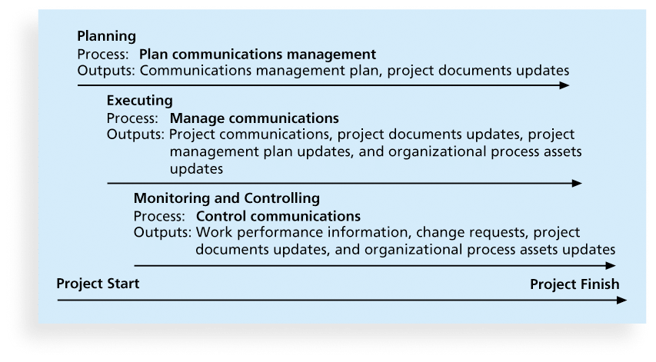
Figure 10-1. Project Communications Management Summary

Slide 6
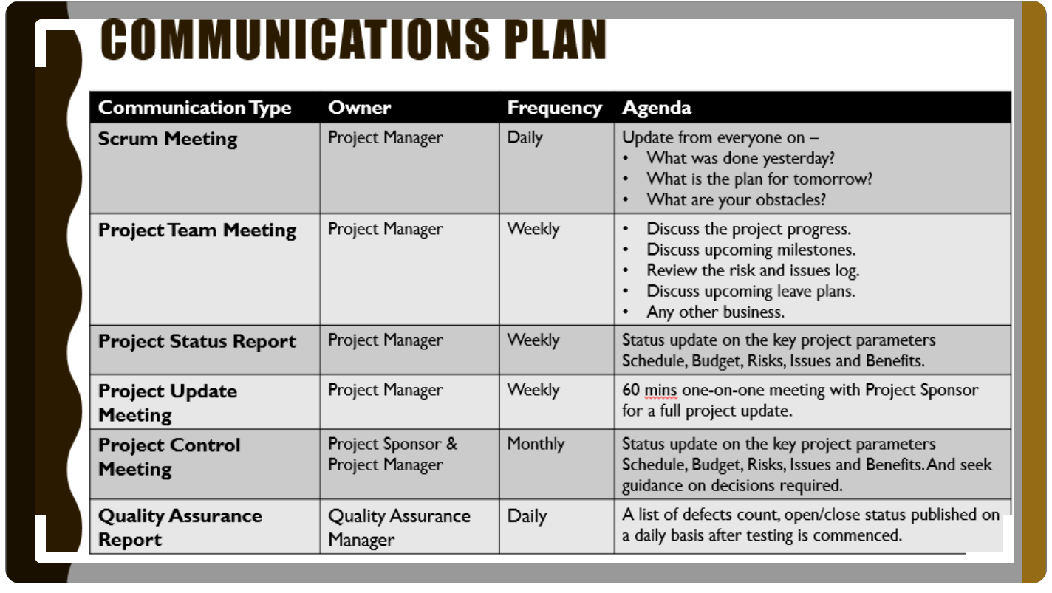

Slide 7
Keys to Good Communications
Project managers say they spend as much as 90 percent of their time communicating
Need to focus on group and individual communication needs
Use formal and informal methods for communicating
Distribute important information in an effective and timely manner
Set the stage for communicating bad news
Determine the number of communication channels
Notes:
văn bản chính thức
văn bản không chính thức
bằng lời nói chính thức
bằng lời nói không chính thức

Slide 8
Determining the Number of Communications Channels
As the number of people involved increases, the complexity of communications increases because there are more communications channels or pathways through which people can communicate.
Number of communications channels = n(n-1)
2 where n is the number of people involved

Slide 9
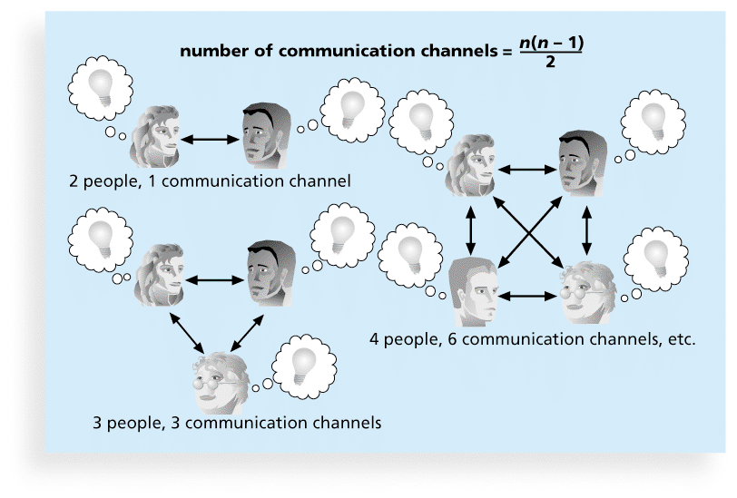
Figure 10-2. The Impact of the Number of People on Communications Channels

Slide 10
10.1.Planning Communications Management
Every project should include some type of communications management plan, a document that guides project communications
The communications management plan varies with the needs of the project, but some type of written plan should always be prepared
For small projects, the communications management plan can be part of the team contract
For large projects, it should be a separate document

Slide 11
Communications Management Plan Contents
1. Stakeholder communications requirements
2. Information to be communicated, including format, content, and level of detail
3. Who will receive the information and who will produce it
4. Suggested methods or technologies for conveying the information
5. Frequency of communication
6. Escalation procedures for resolving issues
7. Revision procedures for updating the communications management plan
8. A glossary of common terminology

Slide 12
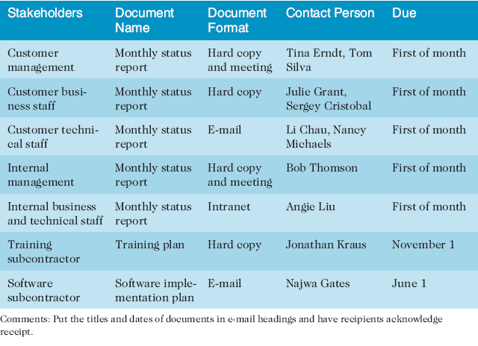
Table 10-1. Sample Stakeholder Analysis for Project Communications

Slide 13
10.2.Managing Communications
Managing communications is a large part of a project manager’s job
Getting project information to the right people at the right time and in a useful format is just as important as developing the information in the first place
Important considerations include the use of technology, the appropriate methods and media to use, and performance reporting

Slide 14
Using Technology to Enhance Creation and Distribution
Technology can facilitate the process of creating and distributing information, when used properly
It is important to select the appropriate communication method and media

Slide 15
Classifications for Communication Methods
Interactive communication: Two or more people interact to exchange information via meetings, phone calls, or video conferencing. Most effective way to ensure common understanding
Push communication: Information is sent or pushed to recipients without their request via reports, e-mails, faxes, voice mails, and other means. Ensures that the information is distributed, but does not ensure that it was received or understood
Pull communication: Information is sent to recipients at their request via Web sites, bulletin boards, e-learning, knowledge repositories like blogs, and other means
Notes:
Giao tiếp tương tác. Giữa hai hoặc nhiều bên thực hiện trao đổi thông tin đa chiều. Đây là cách hiệu quả để đảm bảo những hiểu biết chung bởi tất cả những người tham gia trong một vấn đề cụ thể.
Giao tiếp đẩy (Push communication). Gửi thông tin cho người nhận cụ thể người thực sự cần thông tin đó. Phương pháp này chỉ đảm bảo thông tin được gửi đi chứ không đảm bảo được thông tin đó được hiểu bởi đối tượng. Giao tiếp đẩy thì bao gồm letters, memos, reports, ..
Giao tiếp kéo (Pull communication). Được sử dụng cho khối lượng lớn thông tin hoặc khối lượng lớn đối tượng, và đòi hỏi sự nhận để truy cập các nội dung truyền thông theo quyết định của riêng mình. Những phương pháp này bao gồm các trang web mạng nội bộ, e-learning, bài học cơ sở dữ liệu học, các kho kiến thức, ..

Slide 16
Reporting Performance
Performance reporting keeps stakeholders informed about how resources are being used to achieve project objectives
Status reports describe where the project stands at a specific point in time
Progress reports describe what the project team has accomplished during a certain period of time
Forecasts predict future project status and progress based on past information and trends

Slide 17
10.3.Controlling Communications
The main goal of controlling communications is to ensure the optimal flow of information throughout the entire project life cycle
The project manager and project team should use their various reporting systems, expert judgment, and meetings to assess how well communications are working. If problems exist, the project manager and team need to take action, which often requires changes to the earlier processes of planning and managing project communications
It is often beneficial to have a facilitator from outside the project team assess how well communications are working

Slide 18
Suggestions for Improving Project Communications
Develop better communication skills
Run effective meetings
Use e-mail and other technologies effectively
Use templates for project communications

Slide 19
Developing Better Communication Skills
Most companies spend a lot of money on technical training for their employees, even when employees might benefit more from communications training
Individual employees are also more likely to enroll voluntarily in classes to learn the latest technology than in classes that develop soft skills
As organizations become more global, they realize they must invest in ways to improve communication with people from different countries and cultures
It takes leadership to improve communication

Slide 20
Running Effective Meetings
Determine if a meeting can be avoided
Define the purpose and intended outcome of the meeting
Determine who should attend the meeting
Provide an agenda to participants before the meeting
Prepare handouts and visual aids, and make logistical arrangements ahead of time
Run the meeting professionally
Set the ground rules for the meeting
Build relationships

Slide 21
Using E-Mail, Instant Messaging, Texting, and Collaborative Tools Effectively
Make sure that e-mail, instant messaging, texting, or collaborative tools are an appropriate medium for what you want to communicate
Be sure to send information to the right people
Use meaningful subject lines and limit the content of emails to one main subject, and be as clear and concise as possible
Be sure to authorize the right people to share and edit your collaborative documents

Slide 22
Sample Collaborative Tools
A SharePoint portal allows users to create custom Web sites to access documents and applications stored on shared devices
Google Docs allow users to create, share, and edit documents, spreadsheets, and presentations online
A wiki is a Web site designed to enable anyone who accesses it to contribute or modify Web page content

Slide 23
Using Templates for Project Communications
Many technical people are afraid to ask for help
Providing examples and templates for project communications saves time and money
Organizations can develop their own templates, use some provided by outside organizations, or use samples from textbooks
Recall that research shows that companies that excel in project management make effective use of templates

Slide 24
Lessons Learned Reports
The project manager and project team members should each prepare a lessons-learned report
A reflective statement that documents important things an individual learned from working on the project
The project manager often combines information from all of the lessons-learned reports into a project summary report

Slide 25
Project Archives
It is also important to organize and prepare project archives
Project archives are a complete set of organized project records that provide an accurate history of the project
These archives can provide valuable information for future projects as well
Notes:
Archives = documents

Slide 26
Chapter Summary
The goal of project communications management is to ensure timely and appropriate generation, collection, dissemination, storage, and disposition of project information
Main process include:
Plan communications management
Manage communications
Control communications

